Slide 1


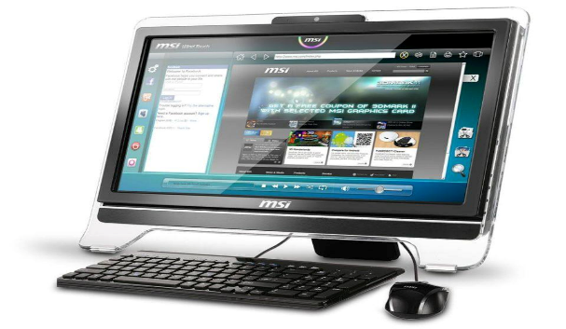
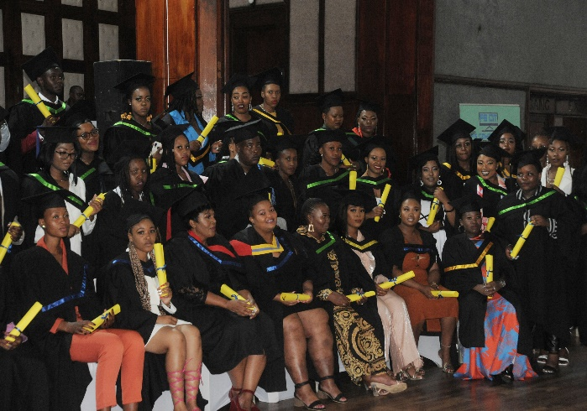
Registration is always open
Registration from R500.00
Instalment from R600.00
COURSES OFFERED
Computer Clerk : R4000.00
Advanced Computer : R4800.00
Intermediate Computer: R5800.00
Office Administration: R6300.00
Data Capture : R6700.00
Secretarial Skills : R6300.00
End User Computing : R9900.00
FETC :Technical Support : R10500.00
FETC: System Development: R12500.00
Our Contacts Details
Tel: 0571010009
Cell: 0734008287
Cell: 0724609046
Facebook Page: Compusteps and Information Technology FS
Website: www.fscompusteps.co.za
Email: info@fscompusteps.co.za
Accredited with MICT SETA
Accreditation Number: ACC/2018/04/0003
Requirements
Proof of Address
Certified ID Copy
Registration Fee No Matric Needed
Full-Time and Part-Time Classes Available
Branches: Welkom CBD, Virginia , Bothaville , Bultfontein

